Slide 1
SUMMER 2023 INTERNSHIP PRESENTATION
By Udit singh guleria
Notes:
Hello everyone,
Over the past 12 weeks, I've had the incredible opportunity to work as a Product Management Intern here at DDI. Today, I'm excited to share with you the overview and outcomes of my internship experience, focusing on two key projects: the Pipeline Succession Strategy Market Research and the Short Form Video project.

Slide 2
Self Introduction
INTERN: Udit Singh Guleria
ROLE: Product Management Intern
PROJECTS: Pipeline Succession Strategy Market Research & Short Form Video
BACKGROUND: Graduate student at Texas A&M

Slide 3
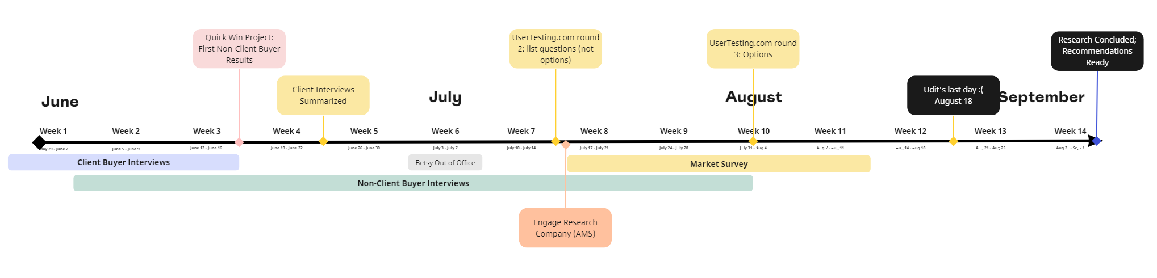
INTERNSHIP TIMELINE May 30 – August 18

Slide 4
PRIMARY PROJECT: Pipeline Succession Strategy Market Research
Goal: Refine post-hire assessment offerings
Collaboration: Betsy Breitenbach
Focus: Client preferences in leadership assessment subscriptions
Notes:
My primary project was centered around refining our post-hire assessment offerings through the Pipeline Succession Strategy Market Research. I worked in collaboration and under the guidance of Betsy on this project. Our goal is to uncover what our clients truly want and value in a leadership assessment subscription.

Slide 5
Market Research Approach
User-centered approach
User interviews as primary research
Sample subscription models by Betsy
Documented interviews and insights by me
Notes:
To gain a comprehensive understanding, we employed a user-centered approach. We conducted in-depth user interviews as our main research method. Betsy, leveraging her prior research, crafted sample subscription models that were then presented to DDI client buyers for feedback. Meanwhile, I took charge of documenting the interviews and extracting meaningful insights.

Slide 6
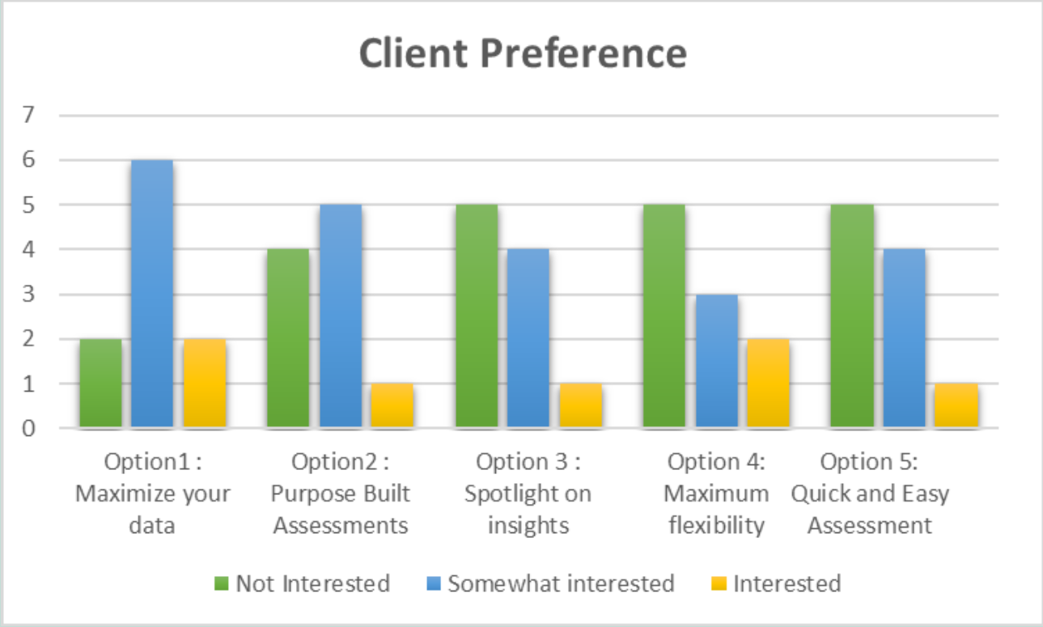
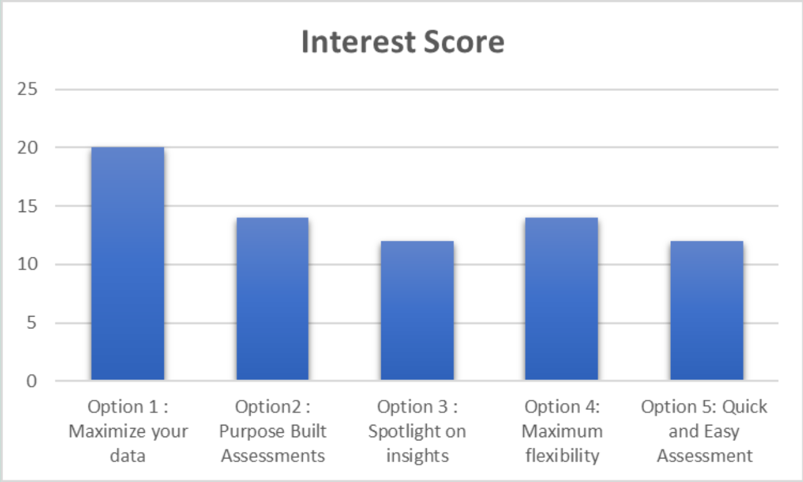
DDI Client Buyer Interviews: Insights and Pain Areas
Sample Subscription models
Option 1: Maximize your data
Holistic Approach: Blend of virtual classroom courses and short assessments.
Quick Insights: 10-minute assessments reveal strengths and growth areas.
Validated Data: Psychometrically validated assessments aid selection decisions.
Augmented Insights: Additional assessments build a comprehensive leader profile.
Long-Term Vision: Track leadership development without lengthy assessments.
Pricing: Based on participants/leaders, ensuring cost-effectiveness.
Notes:
Here I have linked the deck containing information on the subscription models prepared by betsy for Buyer Testing.
We got mixed reviews across the different models. However option 1: Maximize your data scored the highest on interest scale.
Pool of 11 users.

Slide 7
Pain Points
Lack of centralized reporting and tracking
Need for clear and actionable insights
Lack of customization and relevance
Complexity and difficulty of implementation
Notes:
Centralized Reporting: Many interviewees highlighted the challenge of lacking a comprehensive reporting system. They seek a centralized platform for assessing data, results, completion rates, and usage metrics.
Actionable Insights: Interviewees stressed the significance of assessments providing actionable insights. They value clear recommendations and concrete outcomes that can be directly applied to their roles and responsibilities.
Customization & Relevance: Customized assessments aligned with specific roles or organizational needs emerged as a pressing requirement. The struggle with standardized assessments that don't cater to unique demands was a common concern.
Implementation Complexity: Some interviewees struggled with the complexity of certain assessment models. They cited difficulties in decision-making, selecting appropriate assessments, and navigating the intricacies of debriefing processes.

Slide 8
1st Round of User Testing: Quick Win Project
Non Client Buyer Interviews
Key factors in choosing assessments
Intent behind using assessment data
Preferred scoring types
Important purposes of assessments
Prime leadership level targets
Notes:
As a part of my internship program, I had to complete a quick win project, which is basically a task that could be completed quickly with meaningful outcomes For this, I conducted my first round of user testing on user testing.com further which refined our understanding. We learned about the vital factors while selecting leadership assessments, the intent behind using assessment data, preferred scoring types, important purposes of using leadership assessments, and the prime leadership level targets.
These insights allowed us to align our subscription models more closely with client expectations.
Pool of 8 users

Slide 9
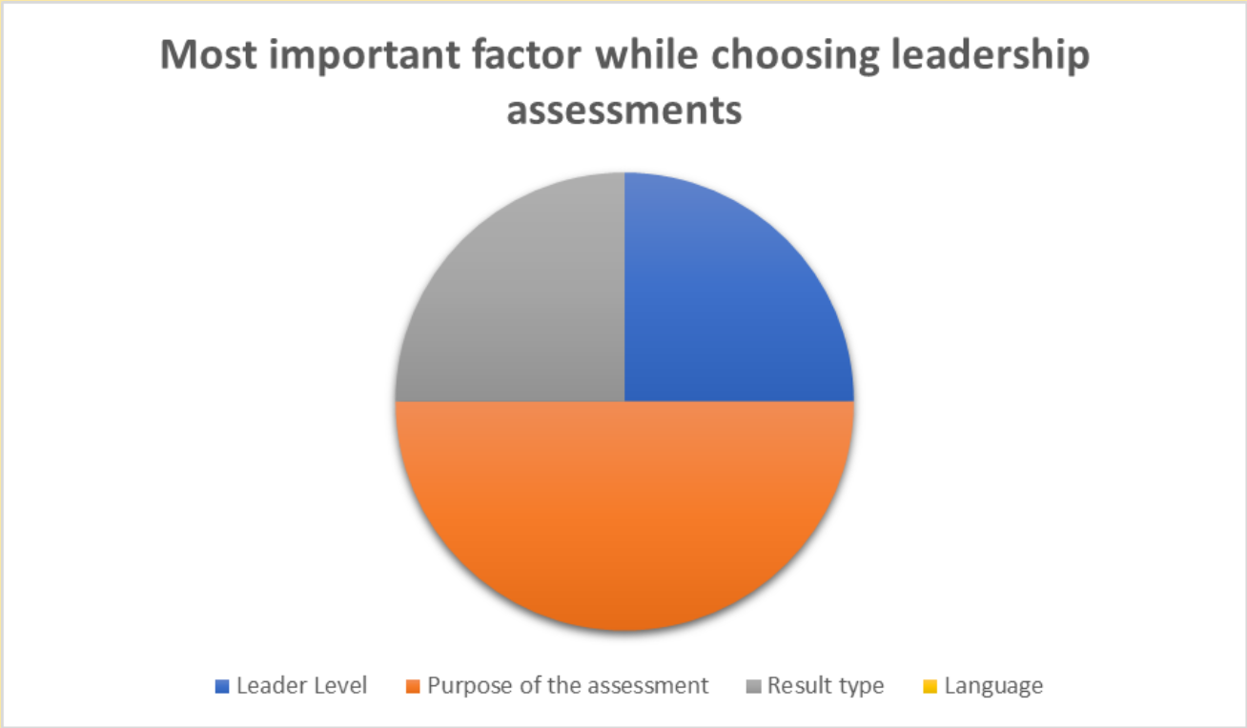
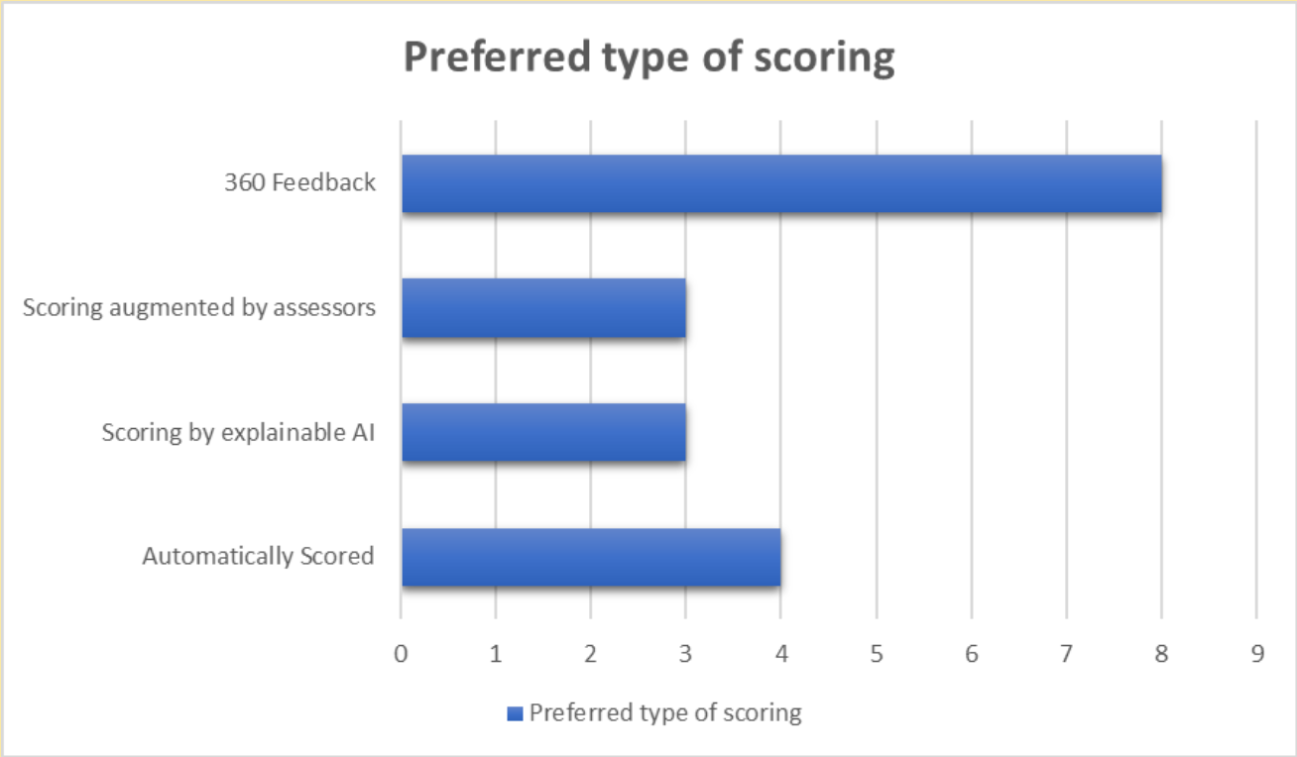
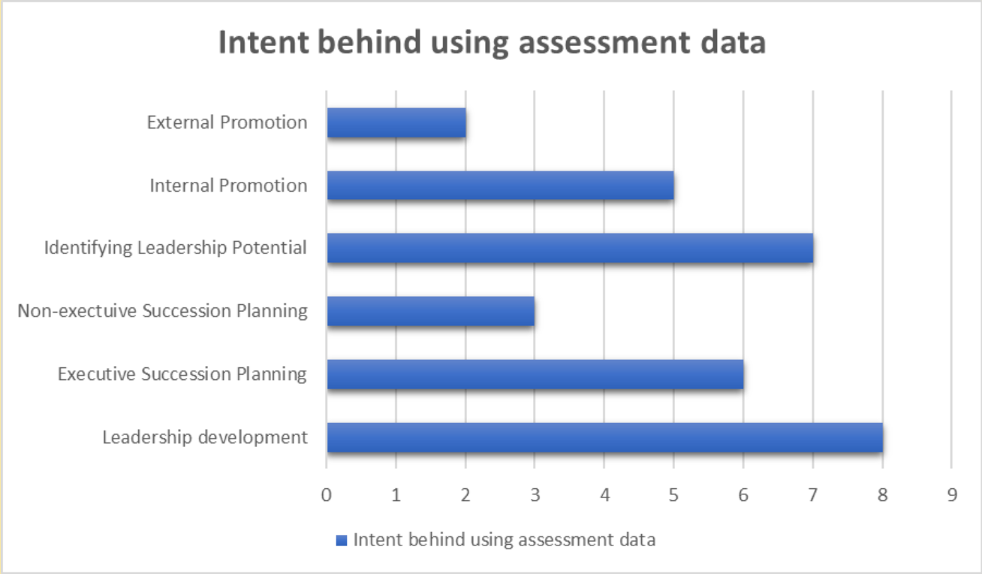
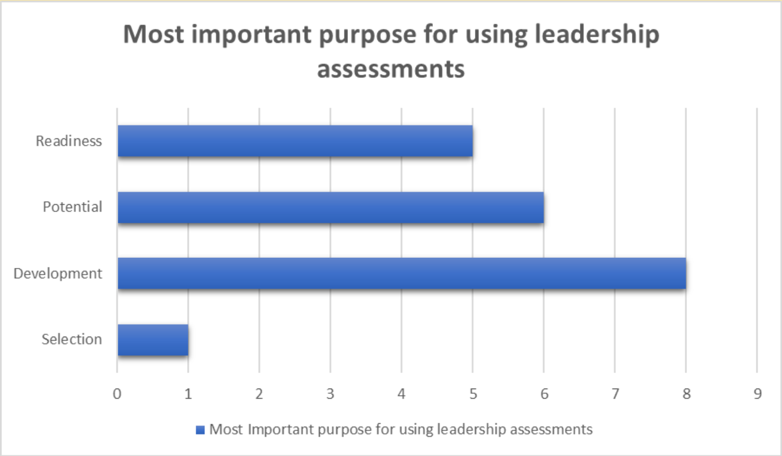
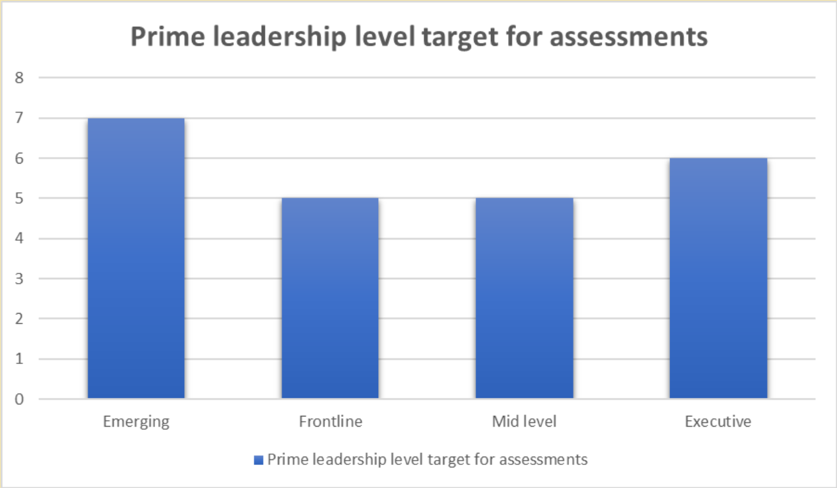
Quick Win Project: Insights

Slide 10

2nd Round of User Testing
Objectives:
Identify Tools Used for Job Analysis
Gather Preference for Manual vs. Automated Job Analysis
Assess Interest in Customization of Assessment Terminologies and Branding
Understand Views on Executive Level Assessments
Explore Perception of Features:
Criterion-Related Validity Studies
Explainable AI
Centralized Reporting
Notes:
"Moving on to the second round of user testing, our objectives were focused on gaining deeper insights into several key areas. These objectives guided us in designing a comprehensive testing process to capture valuable user feedback."
Identifying Tools for Job Analysis:
We aimed to understand the tools and methods participants used for job analysis. This would provide insights into their familiarity with existing processes.
Preference for Manual vs. Automated Job Analysis:
We sought to gauge participants' preferences between manual and automated job analysis methods. This information could shed light on their inclinations towards different approaches.
Customization of Assessment Terminologies and Branding:
We were interested in participants' views on customization options for assessment terminologies and the branding of assessments. This insight would help us tailor assessments to better match their needs.
Views on Executive Level Assessments:
We wanted to know how participants perceived executive level assessments. This understanding would contribute to refining our assessment offerings for leadership roles.
Perception of Features:
We explored participants' opinions on specific features:
Criterion-Related Validity Studies
Explainable AI
Centralized Reporting

Slide 11
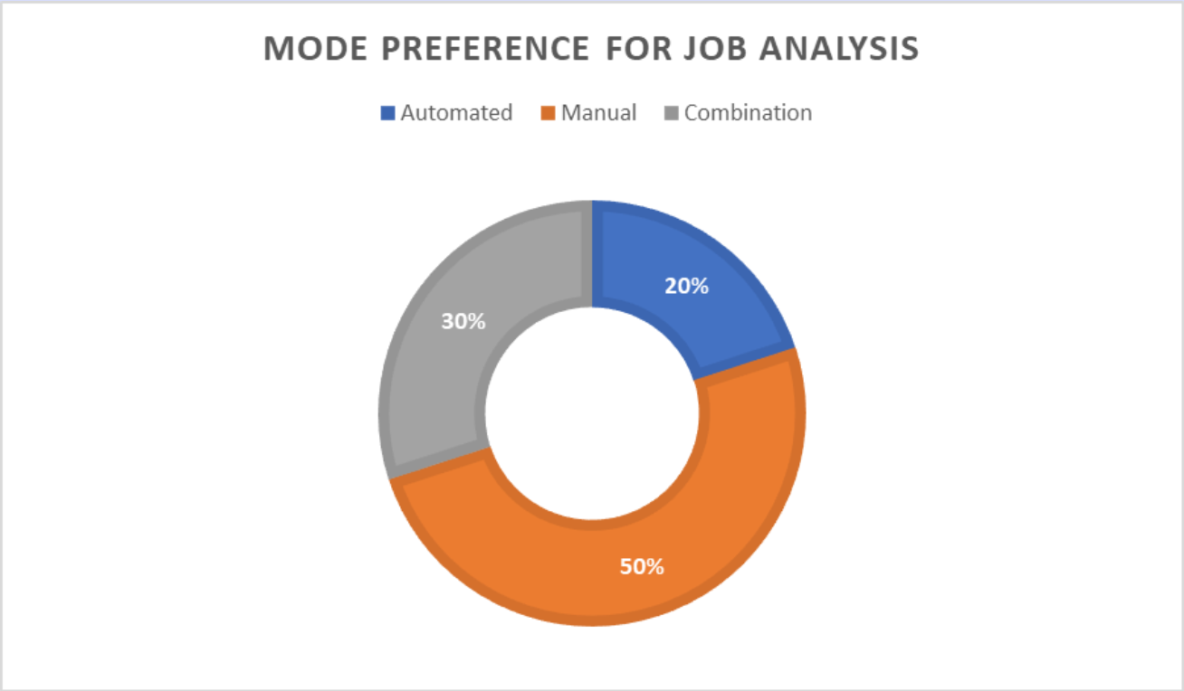
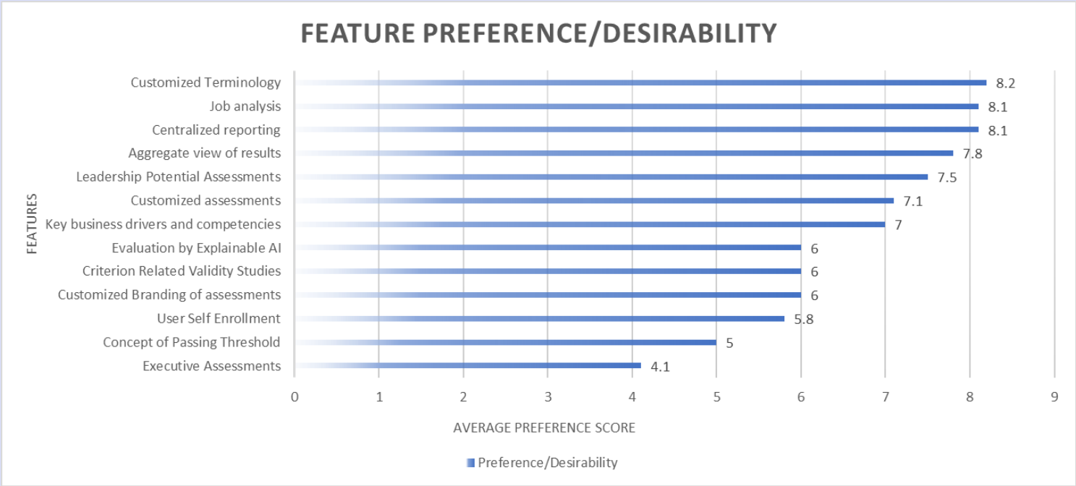
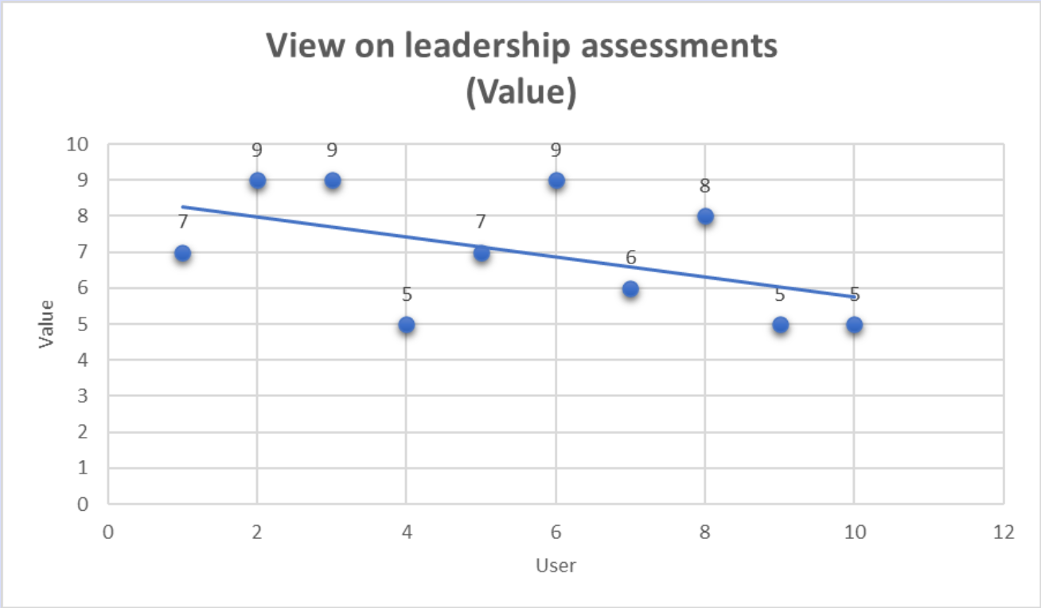
Insights
Emphasis on centralized reporting
Utilization of tools like Workday and Excel
Value of job analysis, especially for lower-level employees
Executive assessments are not seen as a value-add
Criterion-related validity studies are considered essential for leadership assessments.
Desire for customization and participant engagement strategies
Interest in assessing leadership potential
The preference for explainable AI over algorithmic solutions
Notes:
Pool of 10 users:
Centralized reporting is considered crucial for tracking, auditing, and compliance purposes.
The organization uses tools like Workday, Excel, SQL, and Workday Sandbox for job analysis.
Job analysis is highly valued in leadership assessments, with a preference for manual methods.
The alignment of assessments with specific roles is not well established, indicating a need for more customized assessments.
Customization of branding and terminologies/language used in assessments is considered important.
Executive assessments are not seen as a value-add, as they are handpicked and not currently used.
There is strong interest in assessing leadership potential and tracking growth and adaptation over time.
Evaluation by explainable AI is not trusted, and a humanized explanation is preferred.

Slide 12
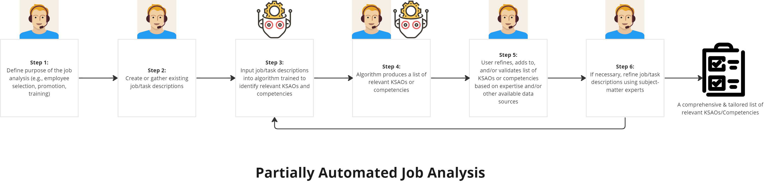
3rd Round of User Testing
Objective
Understand Perception of Job Analysis Labor Intensity
Gauge Openness to Exploring Partially Automated Job Analysis
Assess Expectations from Partially Automated Job Analysis Solutions
Evaluate the Impact of Supporting Research Studies on Adoption Likelihood
Notes:
Moving forward to the third round of user testing, our objectives were aimed at gaining a deeper understanding of participants' perceptions and preferences regarding job analysis processes, specifically in the context of automation."
Understanding Perception of Job Analysis Labor Intensity:
Our goal was to grasp how participants viewed the labor intensity associated with job analysis. This insight helped us assess their current experiences and expectations.
Gauging Openness to Exploring Partially Automated Job Analysis:
We wanted to determine participants' willingness to explore job analysis solutions that incorporate automation. This information indicated their openness to adopting new approaches.
Assessing Expectations from Partially Automated Job Analysis Solutions:
Our objective was to gather insights into what participants expected from partially automated job analysis solutions.
Evaluating Impact of Supporting Research Studies on Adoption Likelihood:
We aimed to understand how supporting research studies influenced participants' likelihood of adopting partially automated job analysis.

Slide 13
Insights
Partial Automation: Users are open to partially automated job analysis for efficiency, while maintaining a balanced mix of automation and manual analysis.
Customization: Customization is a common theme, reflecting the need for tailored job analysis to accommodate organizational growth and unique roles.
Clear Insights: Users value job analysis that provides clear, actionable insights, enabling effective decision-making.
Research Backing: Users are more likely to adopt partially automated solutions with research studies to support their effectiveness.
Notes:
Partial automation is considered a viable approach, as it balances efficiency with the benefits of manual analysis.
Customization remains a key demand, accommodating organizational growth and evolving roles.
The shared desire for clear insights underscores the need for actionable outcomes from job analysis.
Users' openness to research-backed solutions indicates the importance of credible information in decision-making.

Slide 14
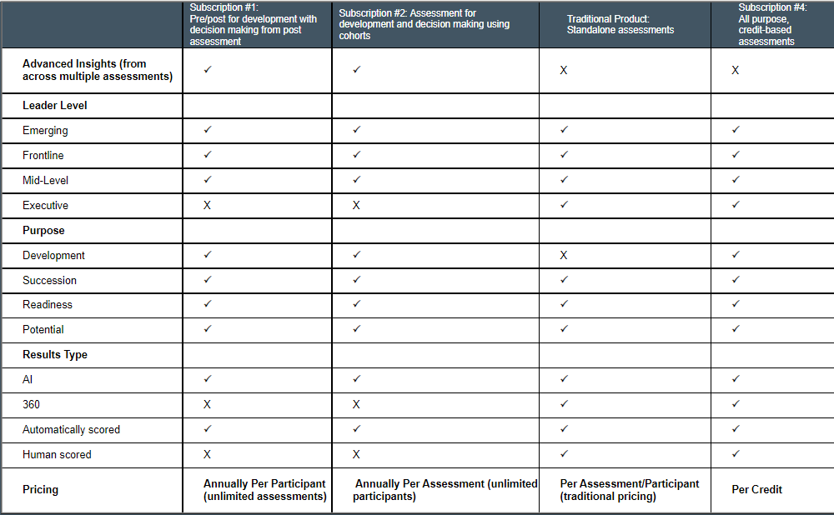
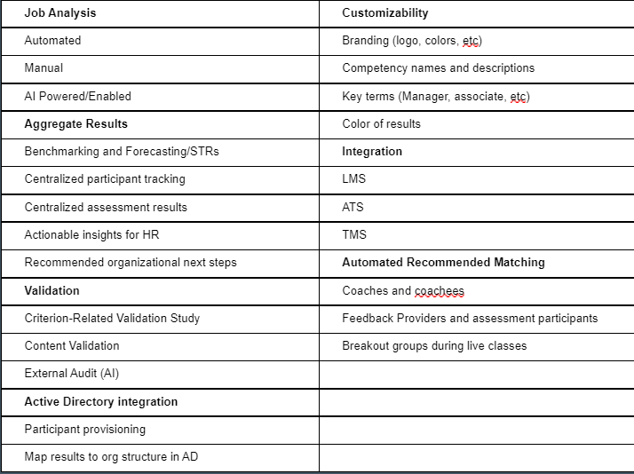
Subscription Model Design and Conjoint Market Survey
Developing Subscription Models:
Based on Comprehensive Market Research
4 Models with Diverse Services and Pricing
Conjoint Market Survey with AMS:
Involving 100 Target Audience Participants
Gauging Clients' Willingness to pay
Collaborative Refinement:
Enhanced Conjoint Screener and Survey Questionnaire
Notes:
Combining these insights, Betsy and I crafted four distinct subscription models. These models varied on the basis of services included and the pricing model. These models laid the groundwork for a conjoint market survey designed in collaboration with AMS. We plan to launch this survey with a pool of 100 users to validate and refine our subscription offerings.

Slide 15
Secondary Project : Short Form Video
Objective:
Engage client users
Drive traffic to DDI's assets
Role:
Content Creation Team Member
Process:
Select topic
Research content
Script creation using template
Co-pilot review
Video recording
Final editing by video editor
Impact:
Enhancing user engagement
Exploring creative strategies
Notes:
Our aim here was to effectively engage our client users and channel their attention towards our assets.

Slide 16
CHALLENGES FACED
New to Conducting Market Research
New to Content Creation
Getting Familiar with New Tools
Getting Familiar with DDI’s Products
Notes:
Learning curve in structuring and executing effective market research
Overcame by seeking guidance from Betsy and learning from experiences Understanding DDI's complex services and offerings
Overcame by immersing in resources, seeking insights from team members
Navigating the process of creating engaging and informative content
Gained proficiency through practice and mentor feedback from Lisa, Danny , Rosey and Allison
Adapting to new software and tools for research, analysis, and content creation
Overcame through training, experimentation, and peer support

Slide 17
Lessons learned
User-Centricity:
Understand and address user needs
User satisfaction drives product success
Iterative Process:
Continuously refine strategies
Incorporate feedback for improvements
Data-Driven Insights:
Informed decisions from research and testing
Validate assumptions with real data
Collaboration:
Cross-team collaboration enhances solutions
Diverse perspectives lead to innovation
Creativity:
Leverage creativity in content creation
Engaging and captivating user experiences
Notes:
User-Centricity:
I learned the significance of understanding user needs and aligning our solutions accordingly. This drove user satisfaction and product success, as evident from our research and testing outcomes.
Iterative Process:
The iterative approach taught me continuous improvement's value. Through regular refinement based on user feedback, our solutions became more effective. Each cycle brought us closer to meeting user requirements and enhancing subscription models.
Data-Driven Insights:
Data-driven decisions became clear during user testing. Incorporating insights from research validated assumptions and tailored offerings to real user preferences. Our final subscription models and conjoint survey validation exemplify this approach.
Collaboration:
Collaborating with Betsy and cross-functional teams showcased diverse perspectives' value. I got to interact with people across DDI with various backgrounds and expertise.
Creativity: I got improve my creative acumen. Working Lisa, Rosey, Danny all of the Short form video project team, encouraged me to learn new creative tools .

Slide 18

Thank You!
Notes:
Before I conclude, I'd like to thank each member of the Product Management team for the incredible opportunity to contribute to these projects and for the support, guidance. I look forward to carrying these learnings forward in my career journey. Thank you once again.“
Please feel free to ask any questions!

